Slide 1
An introduction to Web Engineering
Chapter -1

Slide 2

Why web engineering?
From info medium to Application medium
Web applications today are full-fledged, complex software systems
Technologies and standards are used as a development platform and as a user platform at the same time
Notes:
Web services, are not Web applications, but they can be part of one
Web sites without software components, such as static HTML pages, are not Web applications either

Slide 4
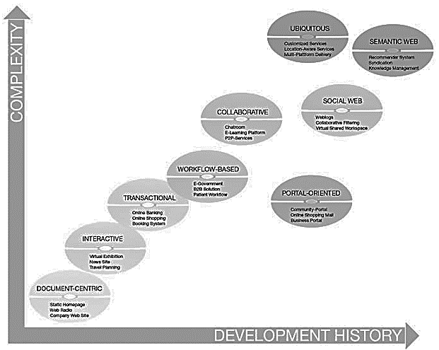
Categories of Web Applications
Document centric
Interactive
Transactional
Workflow-based
Collaborative
Social Web
Portal-oriented
Ubiquitous
Semantic Web
Notes:
Workflow-based applications are transaction-based
the higher level of development requires the previous development of a less complex category.
Exception : Some of the categories (e.g. the portal-oriented applications) are historically rather recent while having a lower degree of complexity
Web application can be started in any of these categories and later expanded to increasing degrees of complexity
Newer categories are generally more complex, but this does not mean they can fully replace the older generation.
Web applications can typically be assigned to several categories at once

Slide 5
Document centric Web application
precursor to Web applications
stored on a Web server as static HTML docs and sent to the Web client in response to a request
updated manually
often results in outdated information
Danger of inconsistencies
simplicity and stability
Short response time
Example:
Static homepages, simple web presences for small businesses belong in this category.
Notes:
Web sites requiring frequent changes or for sites with huge numbers of pages this is a significant cost factor and often results in outdated information. Additionally
Danger of inconsistencies : some content is frequently represented redundantly on several Web pages
for easy acces
Short response time : the pages are already stored on the Web server.
Example : Static homepages, webcasts, and simple web presences for small businesses belong in this category.

Slide 6
Interactive Web application
CGI (Common Gateway Interface) and HTML forms based
Dynamically generated Web pages and links
Example:
virtual exhibitions,
news sites,
timetable information.
Notes:
Web applications emerged, offering a first, simple, form of interactivity by means of forms, radio buttons and selection menus.
Web pages and links to other pages are generated dynamically according to user input

Slide 7
Transactional Web application
more interactivity
Data Driven
Allow info. update by user
efficient and consistent handling of the increasing amount of content
Example:
Online banking,
online shopping
booking systems
Hotel website+room booking system
Notes:
more interactivity : not only interacting with the application in a read-only manner, but also by performing updates on the underlying content.
Data Driven : prerequisite for this are database systems

Slide 8
Workflow-based Web application
handling of workflows within or between different entities
Interoperability
require a certain structuring of the automated processes and operations
Challenges:
complexity of the services
the autonomy of the participating companies
robust and flexible workflow
Example:
B2B solutions in e-commerce
e-government applications in the area of public administration
Web-based support of patient workflows in the health sector.
Notes:
handling of workflows : companies, public authorities, and private users
Interoperability : A driving force for this is the availability of appropriate Web services to guarantee interoperability
Challenges : The complexity of the services in question, the autonomy of the participating companies and the necessity for the workflows to be robust and flexible are the main challenges

Slide 9
Collaborative Web application
Groupware
High degree of communication between the co-operating entities
support shared information and workspaces
Example:
Wiki
Google meet
E-learning platforms (google classroom)
Scheduling systems
Notes:
groupware employed especially for co-operation purposes in unstructured operations
support shared information and workspaces in order to generate, edit, and manage shared information
They are also used to keep logs of many small entries and edits (as in Weblogs), to mediate meetings or make decisions

Slide 10
Social Web application
Find Related objects of interest
Find people with similar interests
people provide their identity to a community of others with similar interests
Example:
blogs
Friendster
Facebook
Quora

Slide 11
Portal-oriented Web application
Central hubs to access web
Provides single point of access to separate, potentially heterogeneous sources of information
specialized portals
business portals
marketplace portals
community portals
Notes:
Business portals give employees and/or business partners focused access to different sources of information and services through an intranet or extranet.
Marketplace portals are divided into horizontal and vertical market places.
Horizontal marketplaces operate on the b2c and b2b selling their products to companies from other sectors.
Vertical marketplaces: companies from a single sector, suppliers on one side and manufacturing companies on the other
Community portals are directed at specific target groups (young people) try to create customer loyalty through
user interaction or to provide individual offers through appropriate user management (one-to-one
marketing).

Slide 12
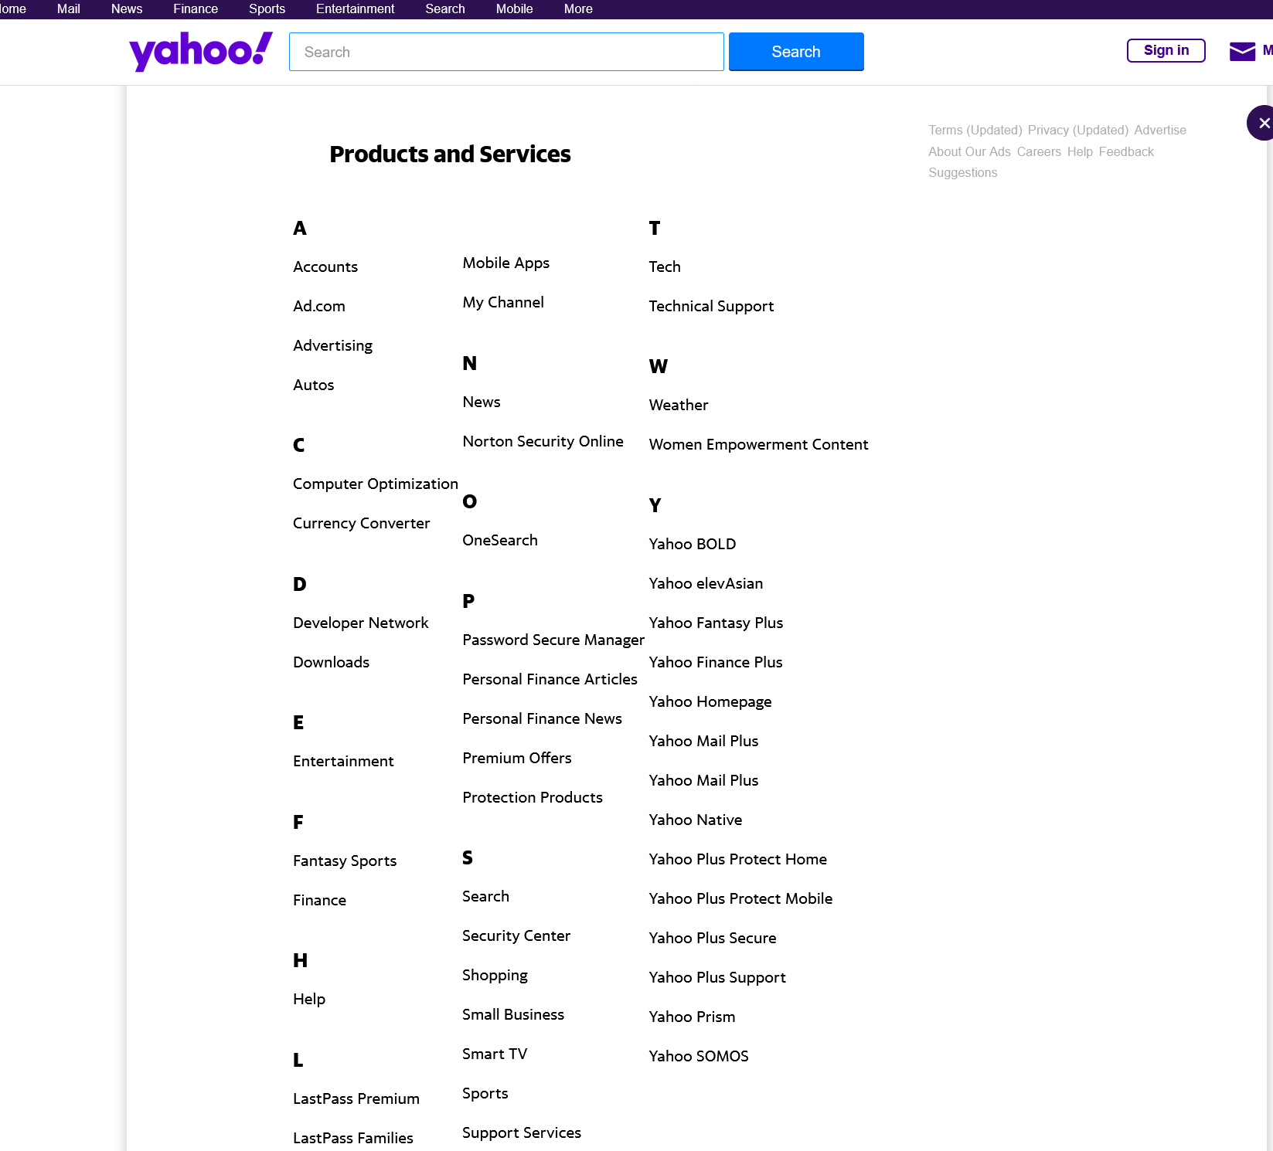
Yahoo!

Slide 13

MSN

Slide 14
Ubiquitous Web application
Customized services anytime anywhere and for any device
personalization (dynamic adjustments according to the users’ situation )
location-aware services
Limitations:
Limitations Of Mobile devices
The context
Notes:
An example
of this would be displaying the menu of the day on the mobile devices of all users entering a
restaurant between 11 am and 2 pm
For this type of system it is important to take into account the limitations of mobile devices (bandwidth, screen size, memory, immaturity of software, etc.) and the context in which the Web application is currently being used. Based on this dynamic adjustments according to the users’ situation can be made
near future where ubiquitous applications will dominate the market.

Slide 15
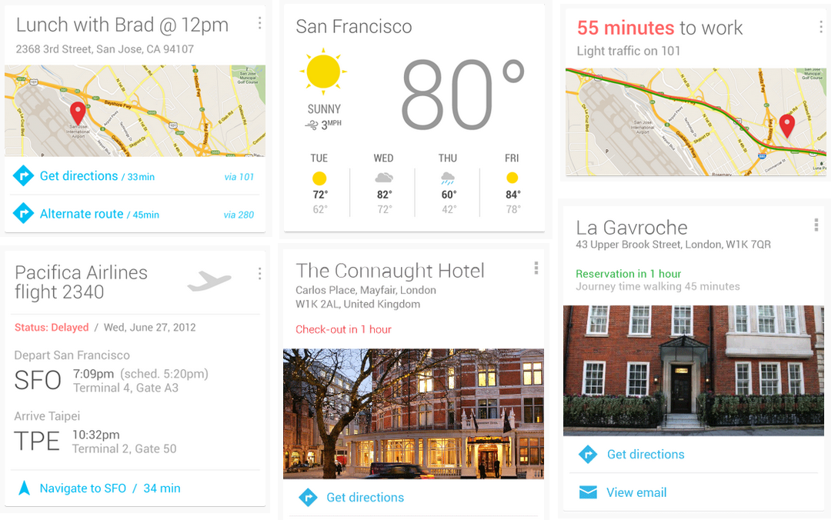
Example of Ubiquitous Web App (Google Now)

Slide 16
Semantic Web application
Presenting information on the Web not only for humans, but also in a machine-readable form
Facilitate knowledge management on the Web
Content syndication
Locating new relevant knowledge, e.g. by means of recommender systems
Supports more ubiquitous
SELECT
price, spec, photo
FROM
Internet
WHERE
product_name LIKE ‘iphone’
Notes:
The goal of the Semantic Web is to present information on the Web not merely for humans, but also in a machine-readable form

Slide 17
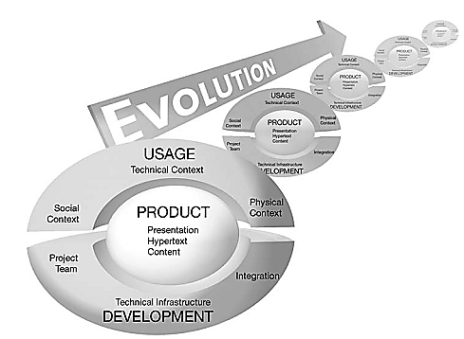
Characteristics of Web Applications
Web applications differ from traditional, non-Web-based applications in a variety of features worth looking into
Characteristics and arranged along 4 dimensions
Product
Usage
Development
Evolution

Slide 18
Characteristics of Web Applications
Product-related Characteristics
Content
hypertextual structure (navigational structure)
presentation (the user interface)

Slide 19
Product-related Characteristics
Content
Content is equally important as the Web application
Web application developers : programmers and authors
provided as tables, text, graphics, animations, audio, or video
Targeted to certain user groups
Content Quality
Update frequency
exact, consistent and reliable

Slide 20
Product-related Characteristics
Hyper-text
a basis for the structuring and presentation of information
Non linear
Basic elements
Nodes : uniquely identifiable info unit
Links : path form one node to another
Anchor :
Problem:
Disorientation: lose ones focus while browsing
cognitive overload : overwhelmed by the amount of info

Slide 21
Product-related Characteristics
Presentation
Two special features of Web applications at the presentation level
Aesthetics
Look-and-feel
Visual presentation of web pages
often determines success or failure
self-explanation
should be possible to use without documentation.
interaction behavior must be consistent

Slide 22
User-related Characteristics
Heterogeneous usages
Users vary in numbers and cultural background
devices have differing hardware and software characteristics
The usage of Web applications is characterized by the necessity to continuously adapt to specific usage situations, so-called contexts

Slide 23
User-related Characteristics
Social Context: Users
Technical Context: Network and Devices
Natural Context: Location and Time

Slide 24
Social Context: Users
Spontaneity:
user cannot be expected to be loyal
users will only use if it appears to bring them immediate advantage.
Unpredictable user load
Scalability is extremely important
Multiculturality
developed for different user groups
large and hardly foreseeable heterogeneities in terms of abilities, knowledge and preferences
Personalization is difficult
User context must be made a development stage

Slide 25
Technical Context: Network and Devices
Quality of Service:
bandwidth, reliability, and varying stability of the connection are independent factors that must be considered to guarantee appropriate quality of service
Multi platform delivary
offer services to devices with very different specifications (e.g. monitor size, memory capacity, installed software)
different browser
difficulties in creating a consistent user interface and in testing Web applications

Slide 26
Natural Context: Location and Time
Globality:
internationalization
location-aware services
security of Web applications (content restriction)
Availability
Immediately available
Permanent availability demand stability

Slide 27
Development-related Characteristics
The Development Team
Technical Infrastructure
Process
Integration

Slide 28
The Development Team
Multidisciplinary

Slide 29
Case Study
SafeHomeAssured.com
Pressman (page-4)

Slide 30
Are WebApps Really Computer Software?
How they are different from
conventional Software?

Slide 31
Attributes that distinguishes them
Network intensiveness
Concurrency
Unpredictable load
Performance
Availability
Data driven
Content sensitive.
Continuous evolution
Immediacy.
Security
Aesthetics

Slide 32
WebE Framework
Chapter -2 (Pressman)

Slide 33
“Web engineering proposes an agile, yet disciplined framework for building industry-quality WebApps.”

Slide 34
What does Agility means
An agile team is a active team able to appropriately respond to changes.
Changes in the software being built,
changes to the team members,
changes because of new technology,
changes of all kinds that may have an impact on the product they build
or the project that creates the product.

Slide 35
What is a WebE Framework?
~ is the foundation for a complete Web engineering process
consist of a small number of framework activities
applicable to all WebApp projects, regardless of their size or complexity.
In addition, the framework encompasses a set of umbrella activities that are applicable across the entire WebE process.

Slide 36
Generic WebE framework activities
Communication
Involves heavy interaction and collaboration with the stakeholders
encompasses requirements gathering and other related activities.
Planning
Establishes an incremental plan for the WebE work
Describes
WebE actions that will occur
technical tasks to be conducted
risks that are likely
Resource required
the work products to be produced,
work schedule.
Notes:
1. A stakeholder is anyone who has a stake in the successful outcome of the project—business
managers, end users, Web engineers, support people, and the like.
2 The phrases process, process model, and process framework are also used in this context.
3 An incremental plan assumes that the WebApp is to be delivered in a series of “increments” that
provide successively more robust sets of requirements with each delivery.

Slide 37
Generic WebE framework activities
Modeling
the creation of models that assist the developer and the customer to better understand WebApp requirements and the design that will achieve those requirements.
Construction
the generation of HTML, XML, PHP, and similar code
testing mechanism that is required to uncover errors in the code.
Deployment
Delivers a WebApp increment to the customer who valuates it and provides feedback based on the evaluation.

Slide 38
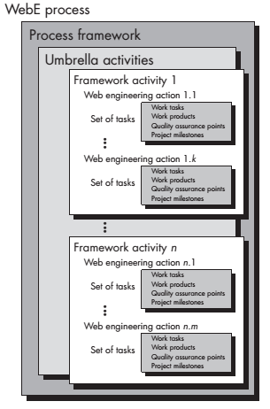
Umbrella activities
risk management,
quality assurance,
content management

Slide 39
Agility principles adapted by WebE Framework user
highest priority is to satisfy the customer through early and continuous delivery of valuable software.
Welcome changing requirements, even late in development.
Deliver working software frequently, from a couple of weeks to a couple of months, with a preference to the shorter timescale.
Business people and developers must work together daily throughout the project.

Slide 40
Agility principles followed by WebE Frameworks
Agility principles adaped by WebE Framework user
Build projects around motivated individuals. Give them the environment and support they need, and trust them to get the job done.
The most efficient and effective method of conveying information to and within a development team is face-to-face conversation.
Working software is the primary measure of progress.
The sponsors, developers, and users should be able to maintain a constant pace indefinitely.

Slide 41
Agility principles adaped by WebE Framework user
Continuous attention to technical excellence and good design enhances agility.
Simplicity—the art of maximizing the amount of work not done—is essential.
The best architectures, requirements, and designs emerge from self organizing teams.
At regular intervals, the team reflects on how to become more effective, then tunes and adjusts its behavior accordingly.

Slide 42
Why Is WebE Process Agility So Important?
The Internet changed software development’s top priority from what to when
Reduced time-to-market has become the competitive edge for successful companies
reducing the development cycle is now one of software engineering’s most important missions

Slide 43
WebE Methods within the Process Framework
Communication methods
Define the approach used to facilitate communication between Web engineers and all other WebApp stakeholders
particularly important during requirements gathering and whenever a WebApp increment is to be evaluated.
Requirements analysis methods
for understanding
the content to be delivered by a WebApp,
the functions to be provided for the end user,
and the modes of interaction that each class of user will require.

Slide 44
WebE Methods within the Process Framework
Design methods
Encompass a series of design techniques that address
WebApp content,
application and information architecture,
interface design, and
navigation structure
Construction methods
Apply a broad set of languages, tools, and related technology to the creation of WebApp content and functionality.
Testing methods
wide array of testing techniques that address component-level and architectural issues, navigation testing, usability testing, security testing, and configuration testing.

Slide 45
Web Engineering Best Practices
Take the time to understand business needs and product objectives, even if the details of the WebApp are vague.
Describe how users will interact with the WebApp using a scenario-based approach.
Develop a project plan, even if it’s very brief.
Spend some time modeling what it is that you’re going to build.

Slide 46
Web Engineering Best Practices (Contd..)
Review the models for consistency and quality.
Use tools and technology that enable you to construct the system
with as many reusable components as possible.
Don’t reinvent when you can reuse.
Don’t rely on early users to debug the WebApp—design comprehensive tests and execute them before releasing the system.

Slide 47
From book
Page 22

Slide 48
A WEB ENGINEERING PROCESS
Chapter 3

Slide 49
Realities encountered in most WebApp projects
Requirements evolve over time
Changes will occur frequently
Time lines are short
Because of these realities, WebApps are often delivered incrementally

Slide 50
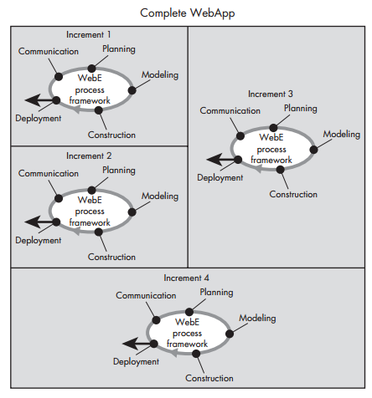
Example: A WebApp delivered in four increments

Slide 51
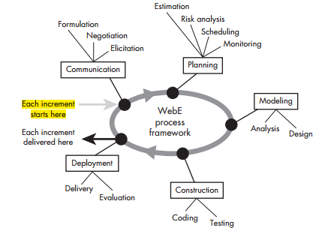
WebE Process Framework

Slide 52
How Is the Framework Refined?
In some cases, a framework activity is conducted informally.
In others, a distinct set of actions will be defined and conducted by team members.
Complex action may be further refined into a set of Web engineering tasks
Example: design
aesthetic design
content design
architecture design
navigation design and
component design

Slide 53

How Should the Communication Activity Be Refined?
Identify business stakeholders
Identify user categories
Formulate the business context
Define key business goals and objectives for the WebApp
Identify the problem
Define informational and applicative goals
Gather requirements
Develop usage scenarios

Slide 54
Planning : Tasks Required to Develop an Increment planning
communication activity provides you with a destination
Planning activity defines the route that you will take you toward the destination
Often defines the way points that will ensure that you’re heading in the right direction and making step-by-step progress
Also defines the resources that will be required to achieve each way point and estimates the time that will be required to get there

Slide 55
Planning: tasks and related questions
Refinement of the description of the WebApp increment to be delivered
Selection of the WebApp increment to be delivered now
Estimation of the effort and time required to deploy the increment.
Assessment of risks associated with the delivery of the increment
Define the development schedule for the increment
Establish of work products to be produced as a consequence of each framework activity
Define your approach to change control
Establish your quality assurance approach

Slide 56
Modeling
What Is Modeling?
Modeling is an activity that creates one or more conceptual representations of some aspect of the WebApp to be built.
conceptual representations
written documents,
sketches,
schematic diagrams,
graphical models,
written scenarios,
paper prototypes,
executable code
Modeling Actions
Analysis
Design

Slide 57
What Analysis Modelling Tasks
Decide whether a requirements model is needed.
Represent WebApp content.
Identify content relationships.
Refine and extend user scenarios.
Review usage scenarios
Create an interaction model for complex scenarios
Refine interface requirements.
Identify functions.
Define constraints and performance requirements.
Identify database requirements.

Slide 58
What Are the Elements of a Design Model
Interface design
Aesthetic design
Content design
Navigation design
Architecture design
Component design

Slide 59
Communication
Chapter 4

Slide 60
Communication
provides the WebE team with an organized way of eliciting requirements from stakeholders.
serves as the entry point for the process flow
Tasks:
ask and answer a set of fundamental questions about the WebApp and its business context (formulation)
elicit requirements that will serve as the basis for all activities that follow, and
negotiate needs against the realities of time, resources, and technology.

Slide 61
What Techniques Can You Use for Communication?
Traditional focus group
Electronic focus group
Iterative surveys
Exploratory survey
Scenario building

Slide 62
Viewpoints differences of stakeholders
business managers
feature set that will result in sales growth and improved revenue for the company
marketing group
features that will excite the potential market, leading to new customers and increased sales
product manager
a WebApp that can be built within budget and that will be ready to meet defined market windows
End users
Features that are already familiar to them and that are easy to learn and use
Web engineers
functions that are invisible to nontechnical stakeholders but that enable the infrastructure that supports more marketable features
Support engineers
the maintainability and extensibility of the WebApp

Slide 63
What Questions Should We Ask?
1. What is the main motivation (business need) for the WebApp?
2. What are the objectives that the WebApp must fulfill?
3. Who will use the WebApp?
See -> page 50 for example

Slide 64
Elicitation
is a requirements-gathering activity involving all stakeholders.
The intent is to describe the problem that the WebApp is to solve (along with basic requirements for the WebApp)
In addition, an attempt is made to identify areas of uncertainty and where potential changes will occur.

Slide 65
basic guidelines for collaborative requirements gathering
A meeting is conducted and attended by all stakeholders.
Rules for preparation and participation are established.
An agenda is suggested that is formal enough to cover all important points but informal enough to encourage the free flow of ideas.
A facilitator (can be a customer, a Web engineer, or an outsider) controls the meeting.
A definition mechanism (can be work sheets, flip charts, wall stickers, an electronic bulletin board, chat room, or virtual forum) is used

Slide 66
What Happens Before an Elicitation Session?
write a one-page WebApp description that will serve as the basis for requirements gathering.
A meeting place, time, and date are selected, and a meeting facilitator is chosen.
All stakeholders are invited to attend.
The WebApp description is distributed to all stakeholders at least 24 hours before the meeting time.

Slide 67
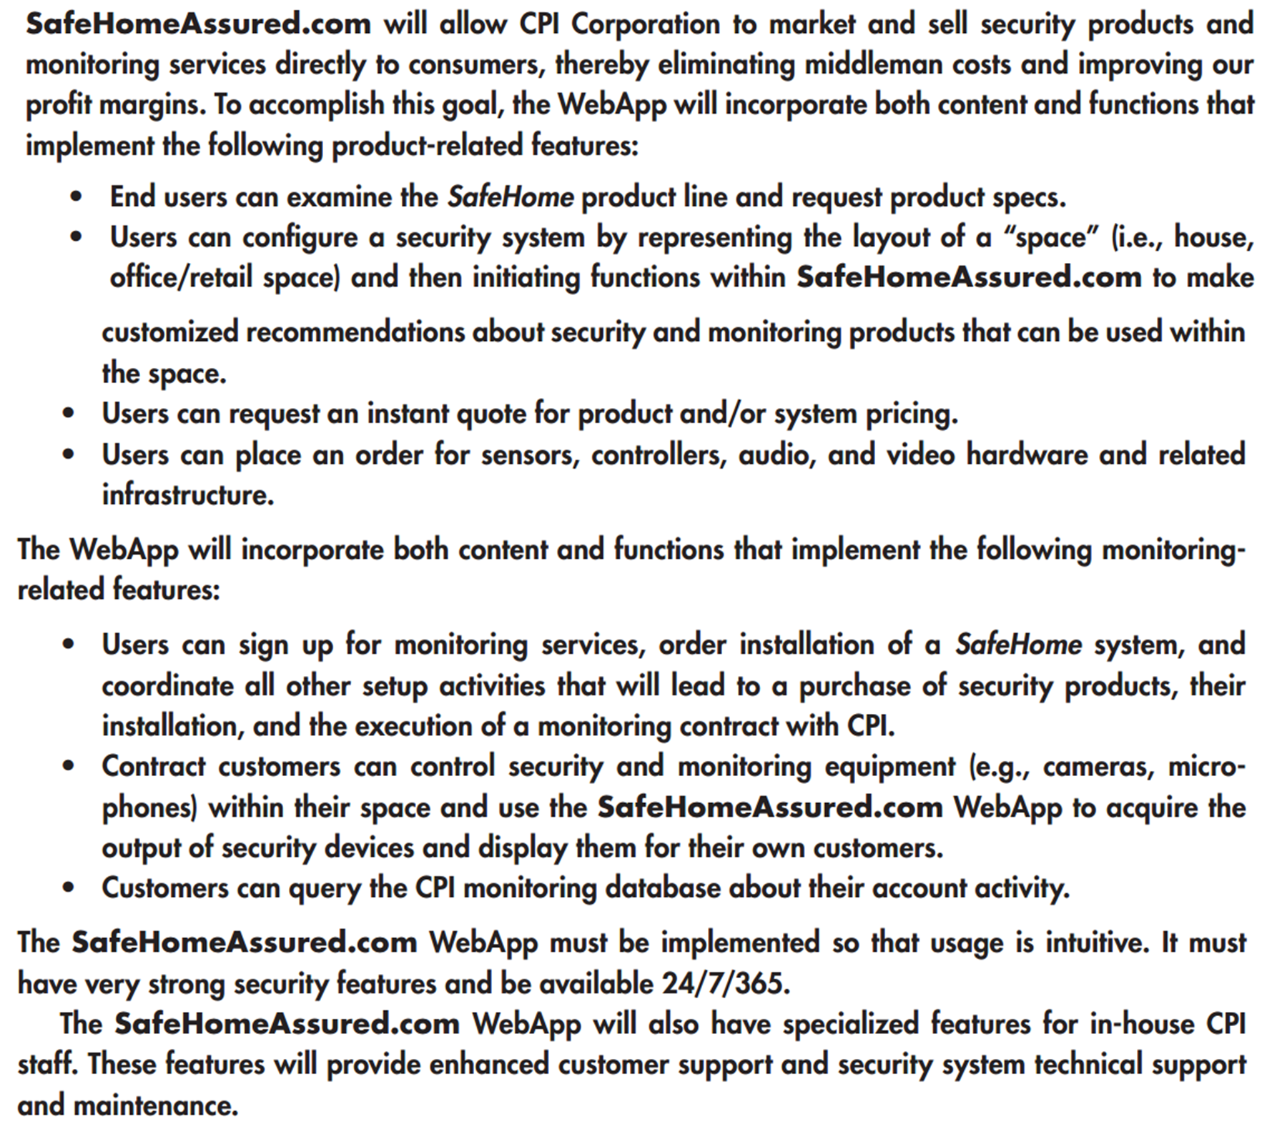

Slide 68
How Do Stakeholders Prepare?
Ask Each stakeholder to review the WebApp description before the requirements gathering meeting and make a list of “content objects”that are:
part of the environment that surrounds the system,
produced by the system, and
used by the system to perform its functions
lists are not expected to be exhaustive but are expected to reflect each person’s perception of the system

Slide 69
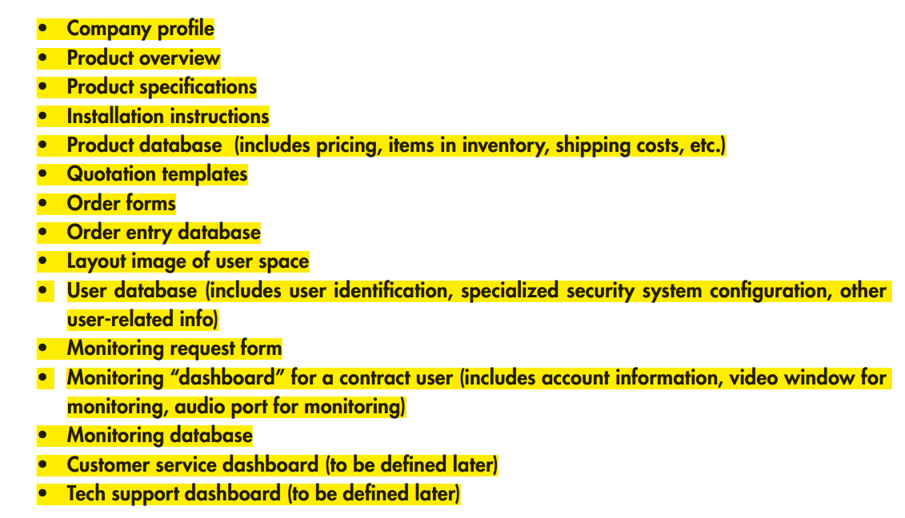

Slide 70
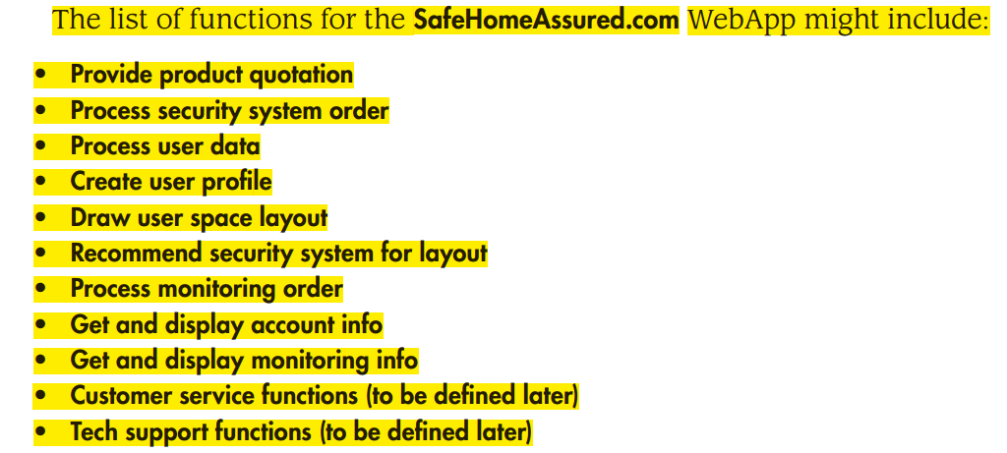

Slide 71
What Tasks Are Performed During an Elicitation Session?
first topic of discussion :
justification for the new product—everyone should agree that the product is justified
Afterward: the facilitator indicates that the group must accomplish four tasks:
Define user categories, and develop descriptions for each category.
Refine content and functionality using the lists each person prepared.
Consider specific constraints and performance issues.
Write user scenarios for each user class.
Not all of these tasks are conducted within the time span of a single requirements
gathering meeting, but all should be accomplished before the WebE process can
proceed.

Slide 72
What Are the User Categories for the WebApp?
A set of fundamental questions must be addressed to define a user category
What is the user’s overall objective when using the WebApp?
What is the user’s background and sophistication level relative to the content and functionality of the WebApp?
How will the user arrive at the WebApp?
What generic WebApp characteristics does the user like and dislike?

Slide 73
How Are Content and Functional Requirements Identified?
Review the list of content object and webApp function prepared by the stakeholders
Combine into a single list with all redundancy removed and present it in the meeting for discussion (see How Do Stakeholders Prepare?)
Allow No critique or Debate
Discuss
shorten, lengthen, or edit the list to properly reflect the WebApp to be developed
Set aside the lists are for later action.

Slide 74
How Are Constraints and Performance Issues Isolated?
Internal constraints
technical environment (in which the WebApp will reside)
specialized database protocols
the vagaries of different Web browsers
operating system characteristics, and
client-server issues
project environment (in which the WebApp will be built)
WebE tools,
development hardware,
software standards, and
Staff skill levels with various WebE technologies

Slide 75
How Are Constraints and Performance Issues Isolated?
External constraints
business and usage environment for the WebApp
Business rules,
end-user idiosyncrasies,
security demands,
privacy issues,
run-time performance,
interoperability requirements,
legal restrictions,
government regulations etc.

Slide 76
Use Cases
Use cases are a widely used approach for the creation of user scenarios. Use cases describe how a specific user category (called an actor) will interact with the WebApp to accomplish a specific action
benefits:
Use cases provide the detail necessary for effective planning and modeling activities.
Use cases help the developer to understand how users perceive their interaction with the WebApp.
Use cases help to compartmentalize Web engineering work because they can be organized into WebApp increments.
Use cases provide important guidance for those who must test the WebApp

Slide 77
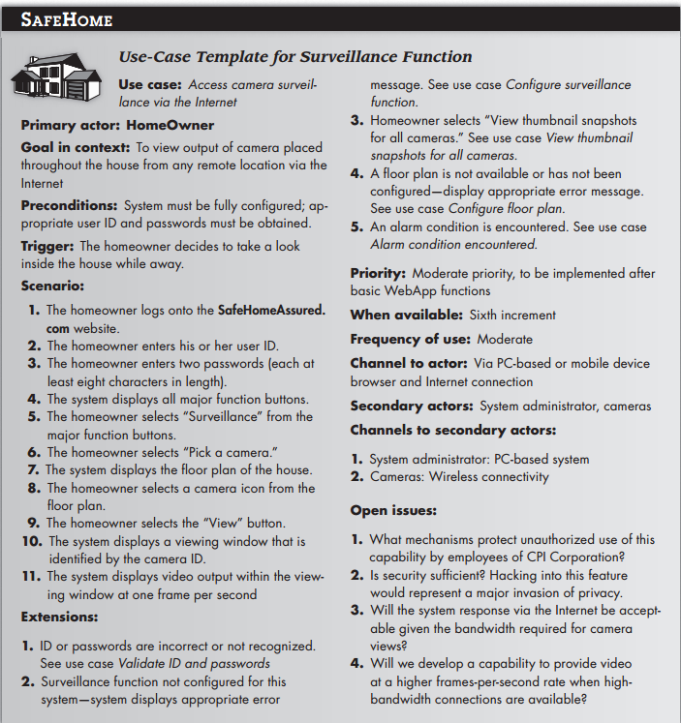

Slide 78
Planning
Chapter 5
Notes:
Everyone plans to some extent, but the scope of planning activities varies among people involved
A Web engineer
day-to-day work—planning,
monitoring, and
controlling technical tasks.
A team leader plans,
monitors, and coordinates the combined work of a WebE team.
Other stakeholders
have little interest in the details of the planning activity,
but are very interested in the outcome.
WebApp increments are delivered over a time span that rarely exceeds 6 weeks
“Do we really need to spend time planning a WebApp effort?
If the WebApp increment is simple functions are straightforward),
planning will take very little time.
If the increment is complex in planning will require greater effort
Regardless of the characteristics of the increment, you must plan.

Slide 79
During Communication Activity We defined Scope
Scope is defined by answering the following questions:
Context. How does the WebApp fit into a business context, and what constraints are imposed as a result of the context?
Information objectives. What customer-visible content objects are used and produced by the WebApp increment?
Functionality. What functions are initiated by the end user or invoked internally by the WebApp to meet the requirements defi ned in usage scenarios?
Constraints and performance. What technical and environmental constraints will impact the framework activities that follow? What special performance issues will require design and construction effort?

Slide 80
All communication work products are relevant to the planning activity.
Statement describing business motivation for the overall WebApp
Statement of overall objective for the WebApp
List of user categories
List of informational goals for the WebApp increment to be planned
List of applicative (functional) goals for the WebApp increment to be planned
Description of the increment (the statement of scope)
List of content objects for the increment
List of functions for the increment
Set of usage scenarios that describe how each user category will interact with the increment
Notes:
it’s not necessarily sufficient for the planning activity.
Sometimes elaboration is needed
You May
proceed with planning and worry about the elaboration during the modeling activity,
do a bit of elaboration now, so that planning can be more reliable,
Do a complete elaboration to be sure you really understand this increment.

Slide 81
What If Gaps Still Exist in Your Understanding?
You’ll have to accept the fact that things remain a bit uncertain,—it’s one of the risks inherent in all engineering work.
You’ll have to complete the planning activity with imperfect information and move on.

Slide 82
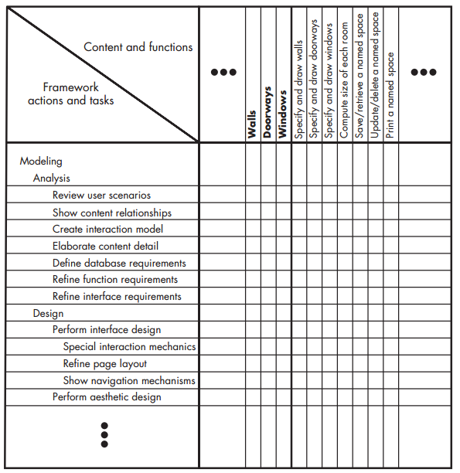
What Actions and Tasks Are Required?
create a task table for
Scenario
Develop a layout of the space to be monitored. [page 72]

Slide 83
What Work Products Will Be Produced?
intermediate work products
modeling representations,
interface sketches,
navigation maps
should be kept to the minimum that is necessary to provide appropriate guidance for the next framework action or task

Slide 84
What Is the Appropriate Way to Assess Quality?
If a WebE team stresses quality in all framework activities, the team reduces the amount of rework that it must do
You must explicitly define meaning of “WebApp quality” and define a set of tasks that will help ensure high quality
WebApp quality
completeness and accuracy of the problem definition,
the commodity of the solution design,
the firmness of construction, and
the overall degree of satisfaction to which the WebApp increment meets the needs of all stakeholders
Notes:
pair programming
Team walkthrough

Slide 85
Why Don’t Teams Jell and What Can Be Done to Help?
frenzied work atmosphere in which team members waste energy and lose focus on the objectives of the work to be performed.
High frustration caused by personal, business, or technological factors that causes friction among team members.
“Fragmented or poorly coordinated procedures” or a poorly defined or improperly chosen process model that becomes a roadblock to accomplishment.
Unclear definition of roles resulting in a lack of accountability and resultant finger-pointing.
“Continuous and repeated exposure to failure” that leads to a loss of confidence and a lowering of morale.

Slide 86
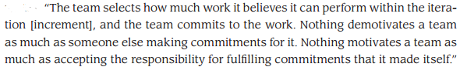
Building a webE team

Slide 87
WebE teams should be self-organizing
A self-organizing team has access to all information required to do the job, thereby avoiding a frenzied work environment in
A self-organizing team has control over
the process that is employed,
the work products that are produced,
the work schedule that is defined, and
the quality and change management activities that are implemented.
Therefore, the team avoids the frustration that occurs when there is a lack of control.

Slide 88
WebE teams should be self-organizing
A self organizing team establishes its own mechanisms for accountability and defines a series of corrective approaches when a member of the team fails to perform.
Every WebE team experiences small failures. The key to avoiding an atmosphere of failure is to establish team-based techniques for feedback and problem solving.
failure by any member of the team must be viewed as a failure by the team itself. This leads to a team-oriented approach to corrective action, rather than the finger-pointing and mistrust that grows rapidly on toxic team

Slide 89
How can a team manage itself
A team leader should be appointed to coordinate communication and work tasks
assess progress and problems by conducting daily team meetings (15 to 20 minutes) to coordinate and synchronize the work that must be accomplished for that day.
These brief meetings address four key questions:
What have we accomplished since the last meeting?
What needs to be accomplished before the next meeting?
How will each team member contribute to accomplishing what needs to be done?
What roadblocks exist that have to be overcome?

Slide 90
How Do We Build a Successful Team?
A set of team guidelines should be established
Strong leadership is a must.
Respect for individual talents is critical.
Every member of the team should commit.
It’s easy to get started, but it’s very hard to sustain momentum.
Notes:
A set of team guidelines should be established. These encompass what is expected of each person, how problems are to be dealt with, and what mechanisms exist for improving the effectiveness of the team as the project proceeds.
Strong leadership is a must. The team leader must lead by example and by contact and must exhibit a level of enthusiasm that gets other team members to “sign up” psychologically for the work that confronts them.
Respect for individual talents is critical. Not everyone is good at everything. The best teams make use of individual strengths. The best team leaders allow individuals the freedom to run with a good idea.
Every member of the team should commit. The main protagonist in Kidder’s book calls this “signing up.”
It’s easy to get started, but it’s very hard to sustain momentum. The best teams never let an “insurmountable” problem stop them. Team members develop a “good enough” solution and proceed, hoping that the momentum of forward progress may lead to an even better solution later in the project.

Slide 91
Characteristics of a Good Team Leader
Motivation. The ability to encourage technical people to produce to their best ability. This can be accomplished by providing incentives for high performance and imposing consequences for poor performance.
Organization. The ability to mold existing processes (or invent new ones) that will enable the initial concept to be translated into a final product.
Ideas or innovation. The ability to encourage people to create and feel creative even when they must work within bounds established for a particular WebApp
Notes:
Motivation. The ability to encourage technical people to produce to their best ability. This can be accomplished by providing incentives for high performance and imposing consequences for poor performance.
Organization. The ability to mold existing processes (or invent new ones) that will enable the initial concept to be translated into a final product.
Ideas or innovation. The ability to encourage people to create and feel creative even when they must work within bounds established for a particular WebApp

Slide 92
Managing Risk
people risks
directly traced to some human action or failing
product risks
can normally be traced to potential problems associated with WebApp content, functions, constraints, or performance
process risks
problems that are tied to the framework actions and tasks that have been chosen by the team
Notes:
people risks
but the team currently has no one with XML experience (technology related)
a specific stakeholder has been uncooperative when information is requested (communication related)
product risks
risk that could impact the tight delivery time of the increment is discovered only after construction has commenced
A major content object is outdated and may require substantial modification
process risks
too much process
work associated with developing a complete analysis model may be too time consuming and will cause a delay in design and construction activities.

Slide 93
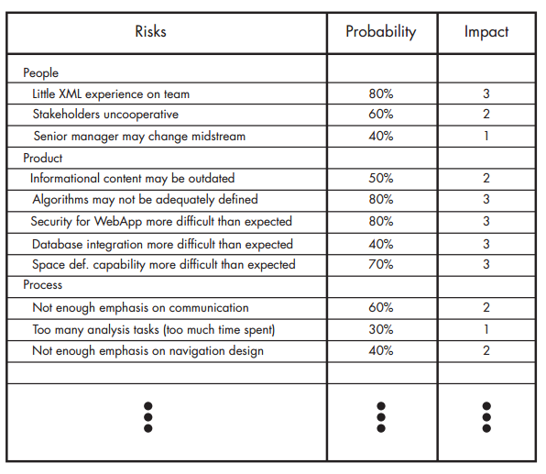
Risk Evaluation
the likelihood or probability that the risk will become a reality,
the consequences of the problems associated with the risk

Slide 94
Contingency Plans
How can we avoid the risk altogether?
What factors can we monitor to determine whether the risk is becoming more or less likely?
Should the risk become a reality, what are we going to do about it?

Slide 95
Developing Schedule
WebApp project scheduling is an activity that allocates the estimated effort for specific WebE tasks across the planned time line (duration) for building an increment
A Macroscopic schedule
Incremental schedule.

Slide 96
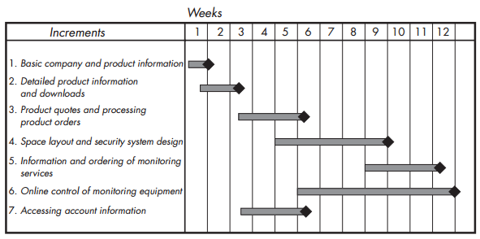
Macroscopic Schedule
identifies all WebApp increments and projects the dates on which each will be deployed

Slide 97
Incremental Scheduling
Expand each task into fine grained tasks.
Design the interface
Develop a sketch of the page layout for the space design page.
Review the layout with stakeholders.
Design the space layout navigation mechanisms.
Design the “drawing board” layout
Develop procedural details for the graphical wall layout function.
Develop procedural details for the wall length computation and display function.
Develop procedural details for the graphical window layout function.
Develop procedural details for the graphical door layout function.
Design mechanisms for selecting security system components (sensors, cameras, microphones, etc.).
Develop procedural details for the graphical layout of security system components.
Conduct pair walkthroughs as required

Slide 98
Estimating Effort and time
usage scenario–based estimation
Examining the team’s past history,
establish a value E_{avg}, the average effort (in person-days) required to deploy a usage scenario
Roughly Calculate the complexity of the scenario

Slide 99
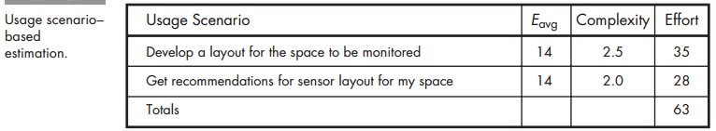
Estimating Effort and time

Slide 100
Estimating Effort and time
Product-process table
all major WebE actions are listed in the first column of the table.
All major content objects and functions for an increment are listed in the first row.
Team members estimate the amount of effort (in person-days) required to perform the WebE action for each content object and function.

Slide 101
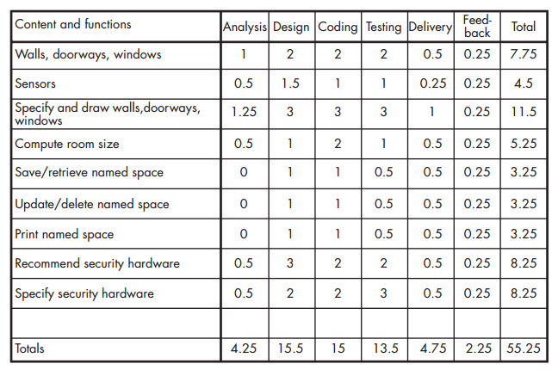
Estimating Effort and time

Slide 102
Managing Quality

